Slide 1
Curriculum Leaders Meeting
April 19, 2024

Slide 2
School Improvement in Kansas
School Improvement in Kansas and KESA 2.0
The role of High-Quality Instructional Materials (HQIM)
Standards Alignment and the Program Managers

Slide 3
Today’s Learning Objective
Participants will identify the why, the what, and the how of School Improvement in Kansas and will know the four components of the School Improvement Model.
Participants will review the KESA 2.0 Collaboration Process and be able to state the three parts of this process.

Slide 4
What one instructional leader activity that you do consistently, yields the highest return on investment?

Slide 5
In the long run, prioritization beats efficiency.
-James Clear

Slide 6
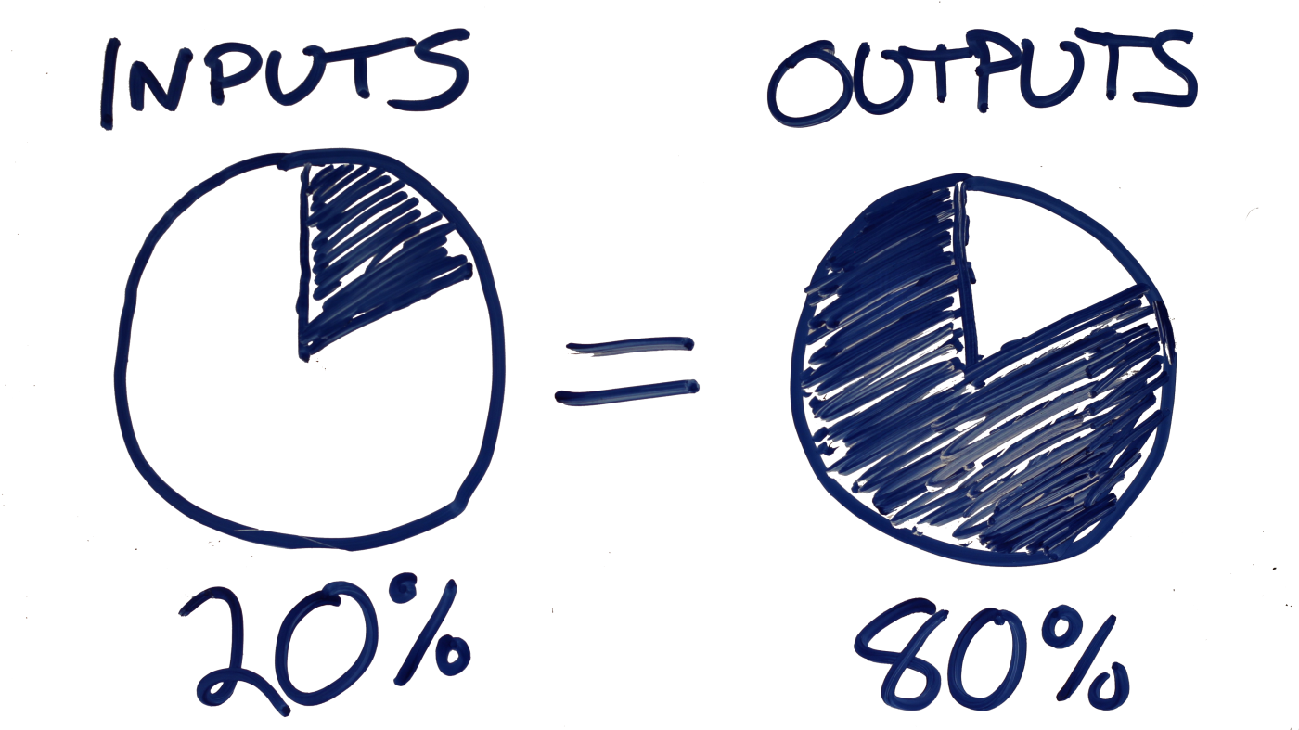
Pareto’s Principle for Principals
Highest ROI Instructional Leader Activity

Slide 7
Pareto’s Principle for KSDE
Focus on Fundamentals in Accreditation

Slide 8
How would you describe your role in KESA 1.0?

Slide 9
The Beginning
The Desire for Coherence
Focus Direction
Build a Collaborative Culture
Deepen Learning
Establish Accountability

Slide 10
The Why
We must reduce limitations and maximize opportunities for each student in Kansas.
Our students need to demonstrate stronger knowledge of our state standards and an ability to use this knowledge in a deeper way.

Slide 11
The What
We will build instructional coherence by focusing on a small number of high-leverage priorities, grounded in research, that elevate teacher and leader practice.
School Improvement in Kansas is characterized by deep implementation of our Fundamentals.

Slide 12
The How
Structures promote instructional coherence and action-based Lead Indicators with associated Measures of Progress provide accountability and a roadmap for quality and depth of sustainable implementation of the Fundamentals.

Slide 13
Keep it Simple
What does this phrase mean to you as a leader?

Slide 14
Fundamentals
Structures
Lead Indicators
Measures of Progress
Structured Literacy
We provide literacy instruction in PreK-12 aligned to the science of reading and assure teachers and administrators are well-trained and knowledgeable in the elements and implementation of structured literacy.
Resource Allocation
Budget emphasis on implementing high-quality instructional materials (HQIM) and professional development aligned to state standards and structured literacy.
HQIM in Budget Line Items
Structured Literacy Training Plan
Standards Alignment Training Plan
Educator Evaluation
Educator goal-setting, observation, and evaluation conversations account for standards in pre-K–12 and optimizing conditions for learning in classrooms.
Educator Evaluation System Tools
Classroom Observation Data
Educator Perception Data
Standards Alignment
We align lessons, instruction, and materials to Kansas standards and clearly identify what students must know and be able to do. This includes interpersonal, intrapersonal, and cognitive skills in pre-K-12.
Professional Learning
District professional development (PD) plan accounts for the alignment of classroom practice with state standards and the implementation of HQIM.
HQIM Implementation in PD Plan
Structured Literacy in PD Plan
Educator Perception Data
Balanced Assessment
We assess students for risk and standards and use data to adjust instruction. We have a deep understanding of the purpose of each assessment and how to use the data to raise achievement.
Professional Collaboration
Collaboration system includes grade level and content area teachers teaming to align standards throughout the school system.
District Collaboration Protocol
Horizontal and Vertical Standards Alignment Process
HQIM Adoption Process
Tiered System of Supports
Data analysis includes screening for risk and performance against standards. Appropriate time is provided for core activities and interventions to meet student needs.
Screening Data
Standards Performance Data
Chronic Absenteeism Data
Instructional Time Schedules
Quality Instruction
We have a culture of high expectations in our classrooms and provide each student access to grade level standards and content though high-quality instructional materials.
Family, Community and Business Partnerships
Families receive student performance data that includes progress on state standards and progress towards Individual Plan of Study (IPS) goals.
Parent-Teacher Conference Protocol and Participation
IPS Scope and Sequence Plans
Notes:
Start with the Whole…
The Fundamentals – Aspirational or Desired State…what does it mean to implement?
The Structures – The elements that shape our professional behaviors…this is the language of school systems
Why do we use the word system – We don’t want anything to happen in isolation
The Handshake and Greeting Principle…
The Lead Indicators – The actions, what we can control and influence, what is indicative of implementing the fundamentals
What is indicative of improving outcomes for students – back to the why
If we take these actions, we will better position students for opportunity, reducing limitations
Measures of Progress – How will we know those actions are occurring
Once a school system commits, how do they show and know they are making progress towards implementation
These are the components of the School Improvement Model
It is not perfect, but we believe it can be highly, highly useful to build the highest degree of coherence in our state

Slide 15
Execution
The plane analogy
The importance of an instructionally focused DLT/BLT structure
Sequencing the KESA 2.0 Collaboration Process

Slide 16
KESA 2.0 Collaboration
District Leadership Teams
School Improvement Day with Like Systems
School Community
Review Guided Reflective Questions in Preparation for School Improvement Day
Review the School Improvement Day Agenda and Expectations
Review Data
Facilitate Protocol Questions to Help Systems Set Direction
Review Action Planning Process
Establish School Community Engagement Plan
Engage BOE, Staff, and Broader Community to Finalize Priorities
Submit Action Plan and Begin Implementation
60 Days
60 Days

Slide 17
Check for Understanding
Why are we doing this work?
What is the work we are doing?
How will we do this work?
What are the components of the School Improvement Model?
What component shapes adult behaviors?
What component is associated with action?
What component tells us if we are making progress with the action?
What are your impressions of everything you have heard so far?

Slide 18
TNTP Instructional Materials Survey

Slide 19
KSDE Program Managers April 19, 2024
Notes:
Laurie

Slide 20

Standards Alignment
"We align lessons, instruction and materials to Kansas standards and clearly identify what students must know and be able to do. This includes interpersonal, intrapersonal and cognitive skills in PreK-12."
This is the focus for 2024-2025 school year.

Slide 21

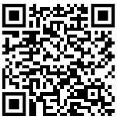
Diamond Discussion Model
Silent thinking and writing time. Only write in your "corner" (3 Minutes)
Each member will read their response to the group (and you can add on while you speak)
(1 Minute each).
One student writes/types a summary in the diamond of what the group agreed / disagreed on. Group members help the writer include all of the important details that your group discussed.

Slide 22
Student 1
Student 2
Prompt: "We align lessons, instruction and materials to Kansas standards and clearly identify what students must know and be able to do. This includes interpersonal, intrapersonal and cognitive skills in PreK-12."
What does this definition mean to you?
What questions might you have about "how" this is done?
Group Consensus:
Student 3
Student 4

Slide 23
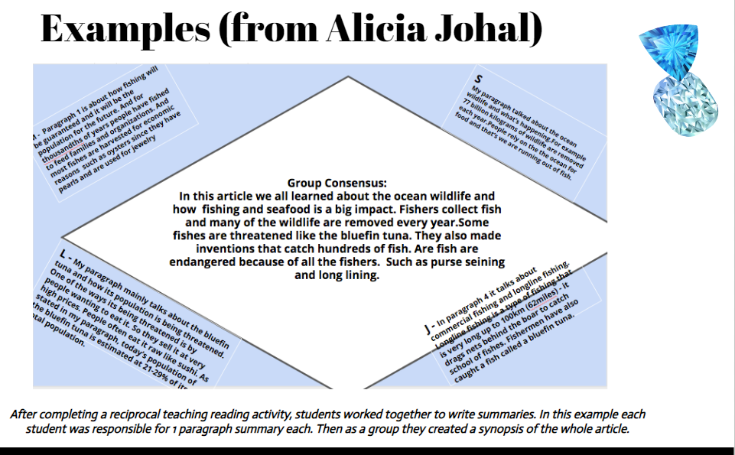

Slide 24

What is the process for Alignment?
KSDE Standards Alignment Toolkit
    Vertical Alignment
    Learning Progressions
    Appropriate Rigor
    Depth of Knowledge
    Questioning Strategies
    Professional Learning Community Conversations
Curriculum and Resource Alignment
Needs Assessment
Curriculum Alignment and Evaluation
Resource Alignment and Evaluation

Slide 25
What is the process for Alignment?
Standards Adoption Timeline
  Intentional consideration towards coherence.
    Standards adoption and assessment development on the same timeline
    We do not foresee large scale changes to the standards in the near future
    NOW is the time to adopt High Quality Instructional Materials (HQIM)
  Additional support and guidance materials
  may be revised.

Slide 26
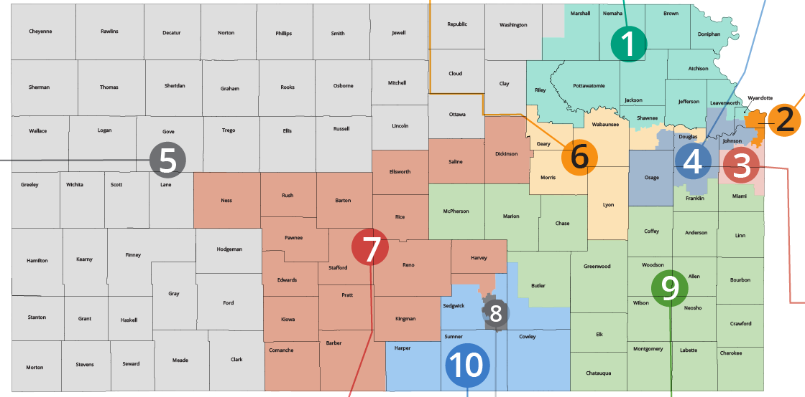
What is the process for Alignment?
Standards Alignment Trainings
  Multiple Regional Sites
  4 times a year
  2 years
  Continual Rollout
Notes:
Jennifer

Slide 27
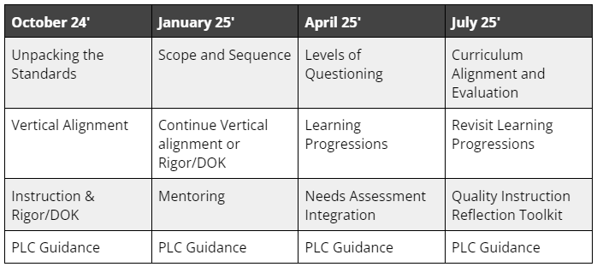
DRAFT
Notes:
Jennifer

Slide 28
Support Available
Cohort of District Identified Classroom Leaders
  Commitment to the process must attend all session
  Professional Learning Certificates
  Modules / resources will be shared with participants to facilitate within district
  Mentoring Opportunities
  Multi-District Collaborations
Notes:
Jennifer

Slide 29
Kick-off / Alignment Opportunities
Anticipated Announcement August 2024
Be sure to check KSDE weekly
Video / module communicating updates on standards and supports focused towards supporting classroom practice
  Think a Bloodborne Pathogens training without the blood
A regular KSDE Curriculum and Instruction zoom
Notes:
Jennifer

Slide 30
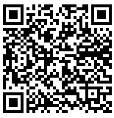
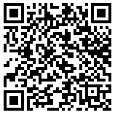
Questions?
Presentation
Hand-out
Notes:
Jennifer

Slide 31
Nathan McAlister
Humanities Program Manager - HGSS, Library, WL, and FinLit
Career, Standards and Assessment Services
(785) 296-3892
nmcalister@ksde.org
Jennifer Hamlet
STEM Program Manager
Career, Standards and Assessment Services
(785) 296-1893
jhamlet@ksde.org
Joann McRell
Humanities Program Manager - ELA
Career, Standards and Assessment Services
(785) 296-2144
jmcrell@ksde.org
Laurie Curtis
Early Literacy & Dyslexia Program Manager
Career, Standards and Assessment Services
(785) 296-2749
lcurtis@ksde.org
Meg Richard
STEM Program Manager - Science
Career, Standards and Assessment Services
(785) 296-8108
mrichard@ksde.org
Notes:
Laurie

Slide 32
Lunch

Slide 33
KSDE Updates
Early Childhood - KELS – Dr. Ben Proctor
Every Child Can Read Act Reporting – End of Year
ELA Crosswalk and State Literacy Plan – Joann McRell
Graduation– Dr. David Fernkopf and Dr. Robyn Kelso
Revised Initial Dyslexia Modules and the new information on Developmental Language Disorder– Dr. Laurie Curtis
KSDE Great Ideas in Education Conference – Dr. Proctor
Licensure Update – Shane Carter
  Registered Apprenticeship
  Limited residency licenses
At Risk Populations and the At-Risk list
CTE programs – Natalie Clark and Helen Swanson
IPS Update – Natalie Clark
Assessment Timeline for New Assessments – Julie Ewing
  Common Assessment Development

Slide 34
Graduation Updates – Post Secondary Assets
Current updates includes the post secondary asset list:
Post Secondary Asset List
The items on the list are official. The agency is developing a process to review the assets and ask for feedback from across the state on what might need to be added or edited. The agency will communicate our formal review process soon, which will require state board approval each year, but again, the list is currently official for the 24-25 school year. Students must acquire a minimum of two post-secondary assets before graduating - can require more if the local district feels this is necessary.
Districts will need to track students' acquisition of post-secondary assets.
Districts will also need to keep tracking students’ acquisition of post-secondary assets once the minimum is met.

Slide 35
Graduation Updates – post secondary assets
Youth Apprenticeships
40 or more Community Service hours
Client-centered Projects
Workplace learning experience directly related to a student IPS
Industry-Recognized Certifications
Seal of Biliteracy
ACT Composite (Score of 21 or higher)
WorkKeys Level (Silver or higher)
9+ College hours
State Assessment scores of 3 or 4 for Math, ELA, Science (demonstrating College Readiness)
ASVAB per requirements of military branch selected
SAT score (1200 or higher)
Completing Board of Regents Curriculum
International Baccalaureate Exam (4+)
Advanced Placement Exam (3+)
CTE Scholar
Eagle Scout or Gold Scout
4-H Kansas Key Award
Two or more high school athletics/activities
JROTC
90% attendance in high school
Senior Exit Interview/Senior Projects
CTSO Officers

Slide 36
New Graduation Requirements Q and A
Please plan to join us on the following dates for additional updates and a Q and A time:
Tuesday April 23 from 2-230pm
Wednesday May 8 from 1-130pm
A third one will be offered in late July or early August. Zoom information will be sent out the week of each event via the Superintendent, Principal and Curriculum Leader Listservs.

Slide 37
Contact Information
Continue to reach out on graduation requirement questions.
  Dr. Robyn Kelso – rkelso@ksde.org
  Dr. David Fernkopf – dfernkopf@ksde.org

Slide 38

Initial Dyslexia Training Modules
Revised and have been piloted.
# 1: KSDE Requirements and District Expectations
# 2: Introduction to Dyslexia: What it is and What it is Not
# 3: How the Brain Learns to Read
# 4: Structured Literacy- Elementary & Middle/Secondary
# 5: Using Information for Transformation

Slide 39
Developmental Language Disorder
The most hidden of disorders
Coexists frequently with dyslexia
approximately 10% of students
The upper strands of the rope
  Do we screen for this?
  What can teachers do to support
  How can we learn more about this?
What do you know about DLD?
How do we help those students who have difficulty with reading as they get older?

Slide 40

Career and Technical Education
R
April 19, 2024
CTE

Slide 41

Career and Technical Education Cluster Reviews
sulta Created Last Year Reviewed Next Projected Review
Agriculture, Food and Natural Resources
Architecture and Construction
Arts, A/V Technology and Communications
Education and Training
Engineering
Finance
Health and Bio Sciences
Learning that works for Kansas
Kansas State Department of Education > Agency > Division of Learning Services > CTE_RecommendationsForPublicComment (ksde.org)

Slide 42
Student Data Management
Opens May 15, 2024, and Due August 15, 2024
Required Data Submission for Perkins
Assigns students to pathways as
  Participants
  Concentrators
  Concentrator Who Exited
  Concentrator Who Exited for Other Reasons
  Completers
Resource: Pathways Student Data Management Checklist
Kansas State Department of Education > Agency > Division of Learning Services > Career Standards and Assessment Services > CSAS Home > Career Technical Education (CTE) > Career Clusters & Pathways (ksde.org)

Slide 43

Required Data Posting
Icon and link must be posted to website - standalones and each member of a consortium
Kansas Career and Technical Education Reports - Data Central (ksde.org)
Standalones and Consortiums will be provisionally approved for Secondary Improvement grant if link is not posted.

Slide 44
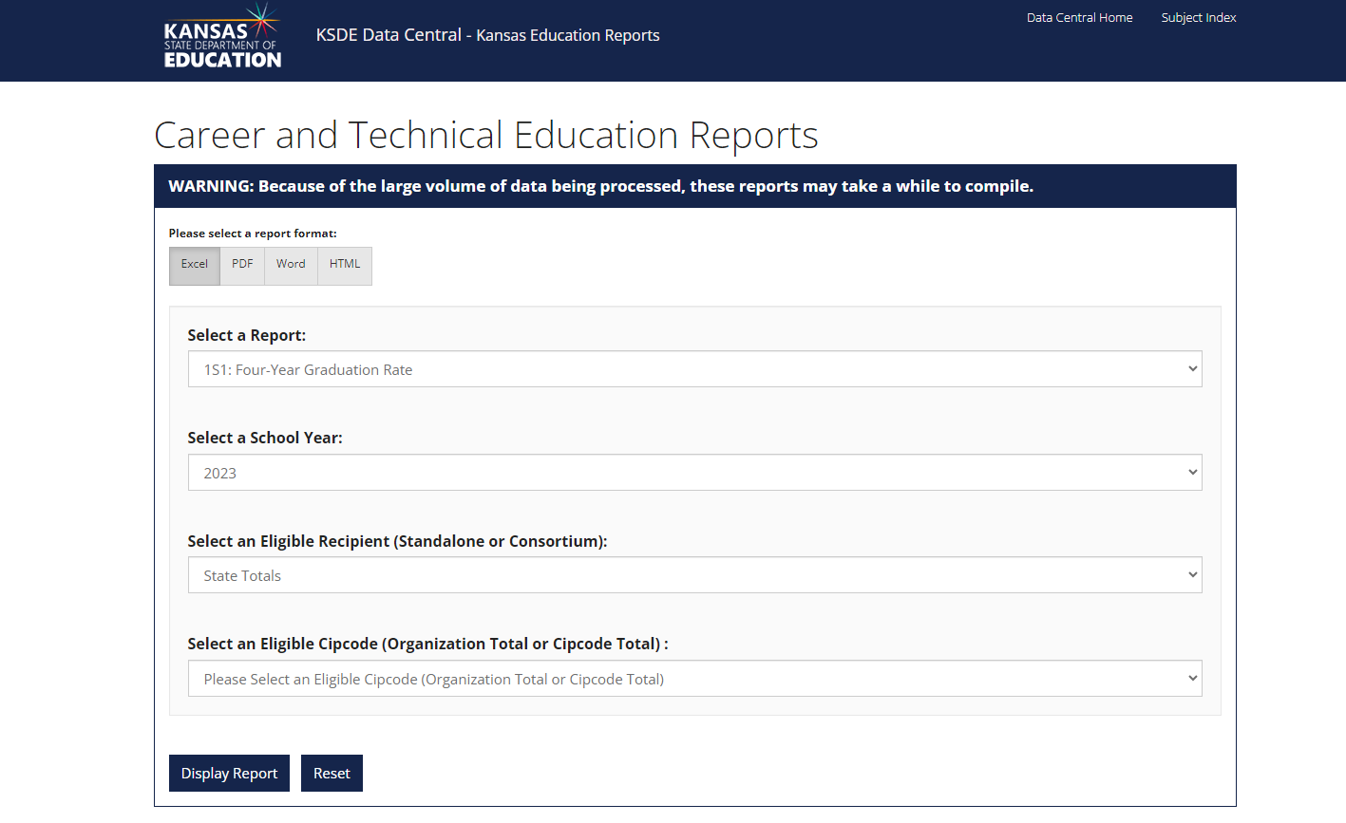
New

Slide 45
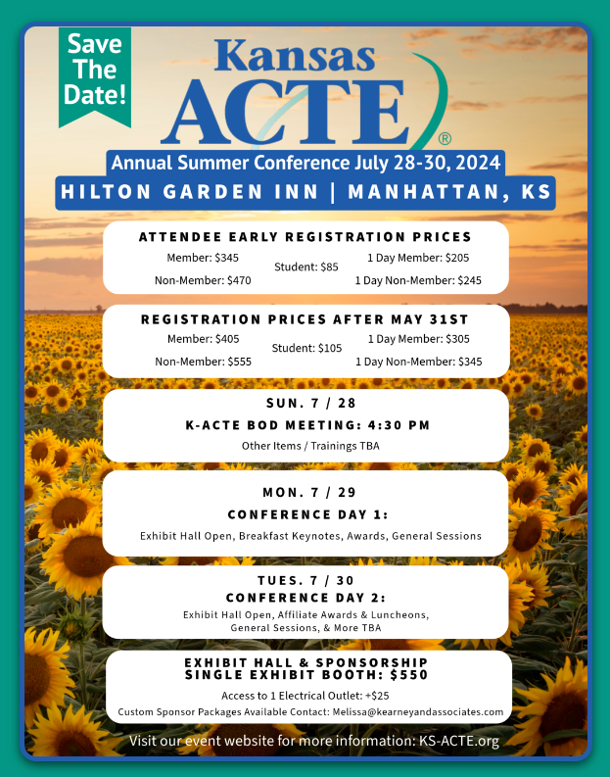
Notes:
https://k-acte-summer-conference-2024.constantcontactsites.com/

Slide 46
Individual Plan of Study
(IPS)

Slide 47
Kansans Can Star Recognition
The Kansans Can Star Recognition Program qualitative measures application open from Jan. 17 through May 3.
Districts can apply in these four areas:
Social-Emotional Growth
Kindergarten Readiness
Individual Plan of Study (IPS)
Civic Engagement
Notes:
IPS Kansans Can Star Recognition Rubric (ksde.org)
Kansans Can Star Recognition Program - IPS Artifacts (ksde.org)
Kansans Can Star Recognition Program: How to Apply (ksde.org)

Slide 48

IPS Annual Survey
KSDE collects data annually on the implementation of IPS from principals, teachers, school counselors, etc. among qualified IPS buildings (with 6th grade or above).
The survey has 18 questions relating to a comprehensive set of components on IPS implementations.
Survey Response Deadline of May 13th.
Notes:
2024 is Year Six

Slide 49

Notes:
https://www.ksde.org/Portals/0/CSAS/Content%20Area%20(F-L)/Elementary%20Career%20Awareness%20Resource.pdf?ver=2024-01-30-131059-923

Slide 50
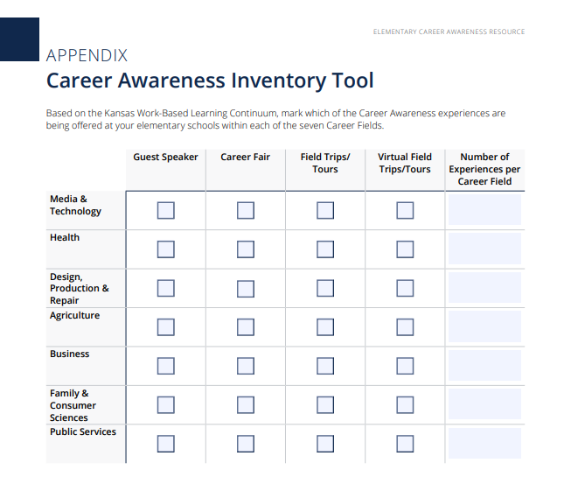

Slide 51
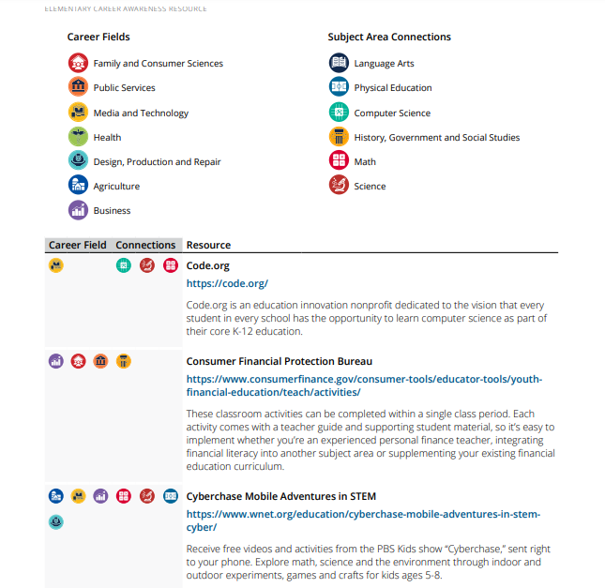

Slide 52

Notes:
https://www.ksde.org/Portals/0/CSAS/Content%20Area%20(F-L)/Middle%20School%20Career%20Exploration%20Resource.pdf?ver=2024-01-30-130933-257

Slide 53

72153 Exploration of Career Pathways
Twenty-five multi-discipline modules created to allow students to demonstrate mastery of their content in a variety of ways driven by their personalized learning interests and goals. Modules include:
● Career Exploration
● Personalized Learning and Student Choice
● Individual Plans of Study (IPS)
● Electronic Exportable Portfolio
Kansas Center for CTE | Home - KCCTE (pittstate.edu)
Notes:
https://library.kccte.pittstate.edu/curriculum/264

Slide 54

For Educators | HirePaths
Cool Careers Videos | HirePaths
Cool Careers Videos | HirePaths
For Educators | HirePaths

Slide 55
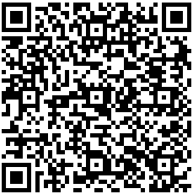
The Students’ Right to Know Act
Passed during the 2021 legislative session
KSDE Responsibilities
Ensure distribution of
The degree prospectus information published by the Kansas Board of Regents. DegreeStats
The Kansas Training Information Program (K-TIP) report.
Other information relevant to the students’ understanding of potential earnings.
KDOL LMI
The potential earnings of the branches of the armed services of the US Military.
  KBOR Military and Veteran Resources
  CareerOneStop (Includes Military Options)
  O*NET OnLine (onetonline.org) (Military Crosswalk)
to students 7-12 grades and their families by October 15th each year.

Slide 56


Today's Occupations: High Demand, High Wage Jobs < Bachelor's (ks.gov)

Slide 57

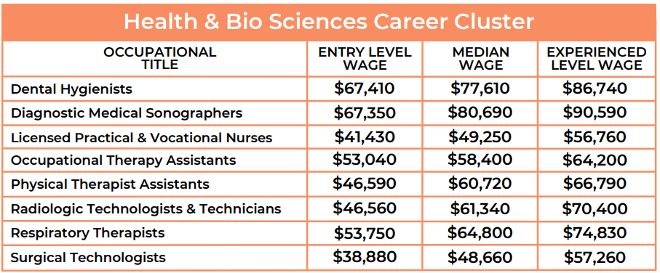
Notes:
Today’s Occupations: A collection of high demand, high wage occupations requiring less than a Bachelor’s Degree. Published 1.2024

Slide 58
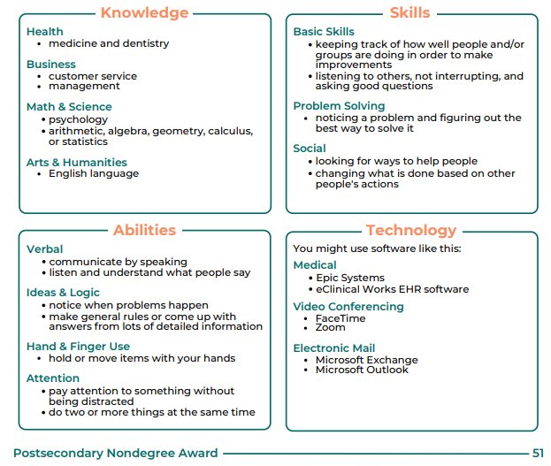
Kansas Labor Information Center (KLIC) - Today's Occupations, Tomorrow's Opportunities (ks.gov)
Notes:
Today’s Occupations: A collection of high demand, high wage occupations requiring less than a Bachelor’s Degree. Published 1.2024

Slide 59
Kansas Labor Information Center (KLIC) - Today's Occupations, Tomorrow's Opportunities (ks.gov)

Slide 60
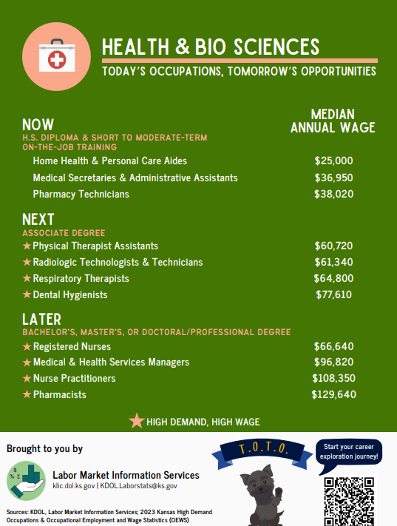
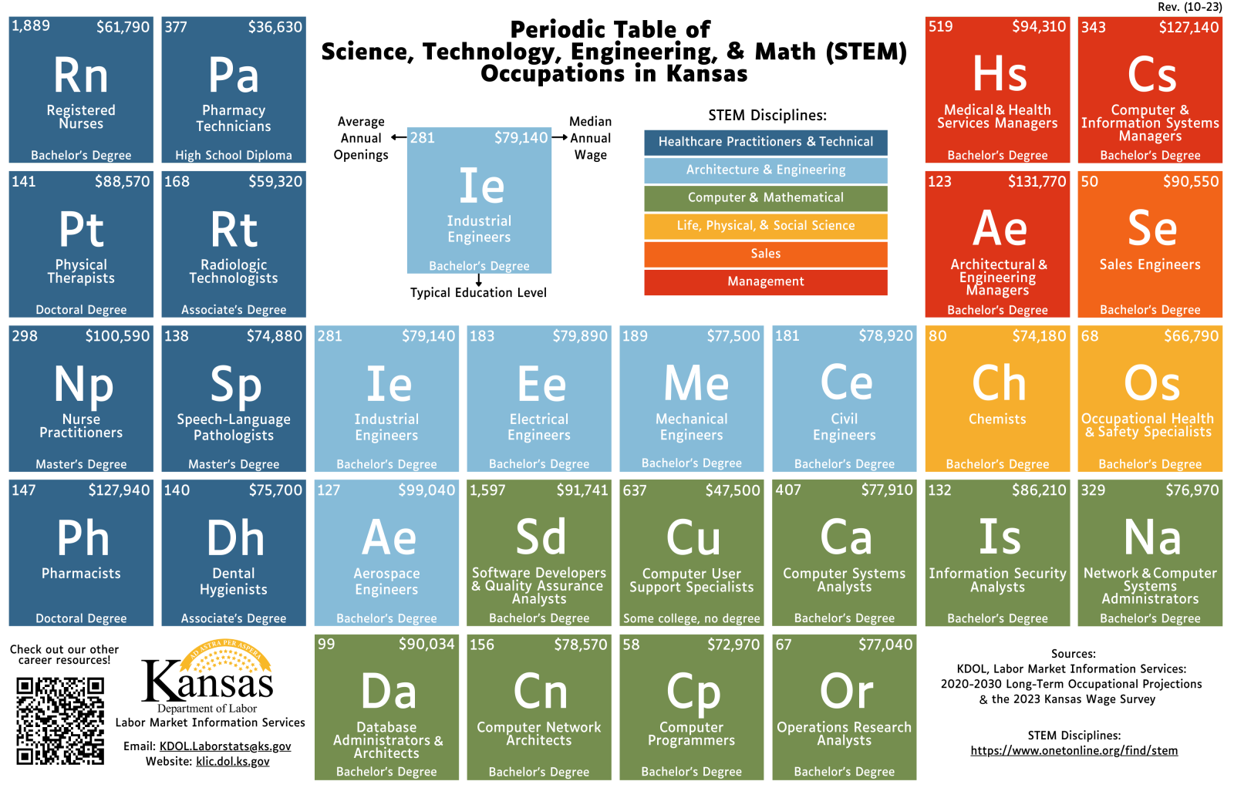
Kansas Career Posters
13 Kansas Career Posters Highlight Potential Career Paths Across Various Career Clusters
Access the posters here.
Notes:
Every occupation on these posters is currently in high demand in the state of Kansas.

Slide 61
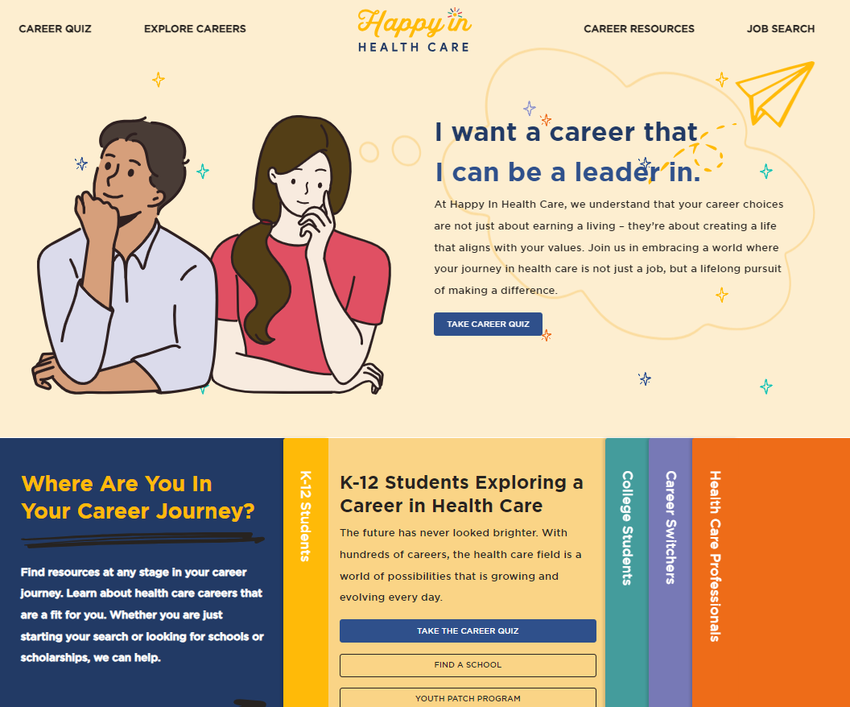
Kansas’ NEW Health Care Careers Website
HappyInHealthCare.Org

Slide 62
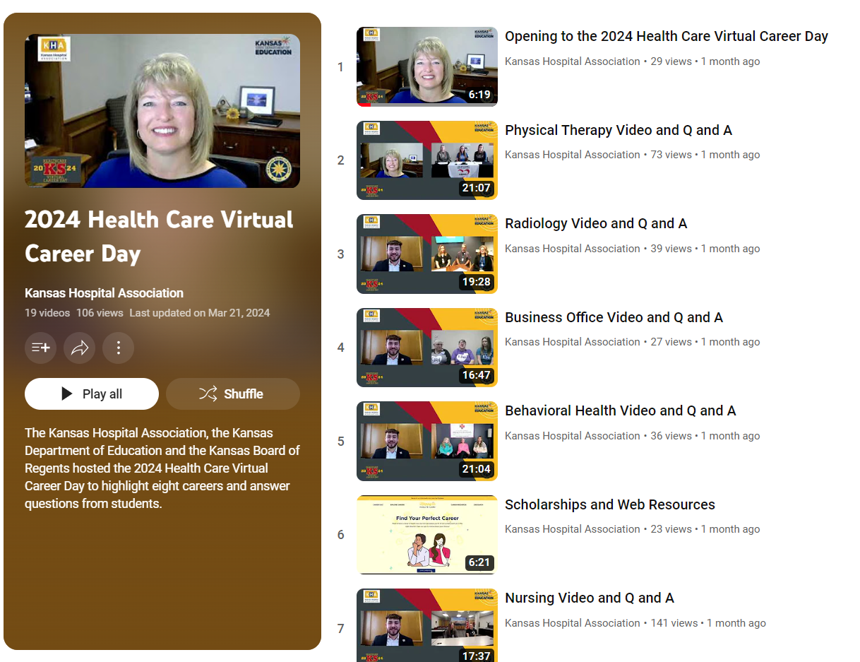

Slide 63
  Natalie Clark
  Assistant Director
  Career, Standards and Assessment Services
  (785) 296-4351
  ndclark@ksde.org
  Helen Swanson
  Coordinator
  Career, Standards and Assessment Services
  (785) 296-4912
  hswanson@ksde.org

Slide 64

Update on New State Assessments Beginning in 2024-2025
Curriculum Leader’s Meeting April 19, 2024

Slide 65
Overview
The Achievement and Assessment Institute (AAI) in partnership with the Kansas State Department of Education (KSDE) determined the content to be assessed by Kansas Assessment Program (KAP) tests for each subject area and speciﬁc grade.
The 2025 English language arts (ELA) summative assessment is aligned to the 2023 Kansas Standards and 2017 Kansas Standards for Mathematics.
The 2025 science summative assessment is aligned to the 2013 Kansas Science Standards.
The 2025 KAP assessments have new blueprints.
All items on 2025 KAP assessments were newly developed and aligned to Kansas Standards.

Slide 66
Development Timeline
Milestone | Date | Note
Blueprint development | 2020-2022
Passage and item development | 2021-2023
Field-tested items | Spring 2022, Spring 2023, Spring 2024 | Newly developed items were field-tested on previous summative assessments.
Test construction | 2024-2025
First operational Summative administration aligned to new blueprint | Spring 2025
Standard setting | Summer 2025

Slide 67
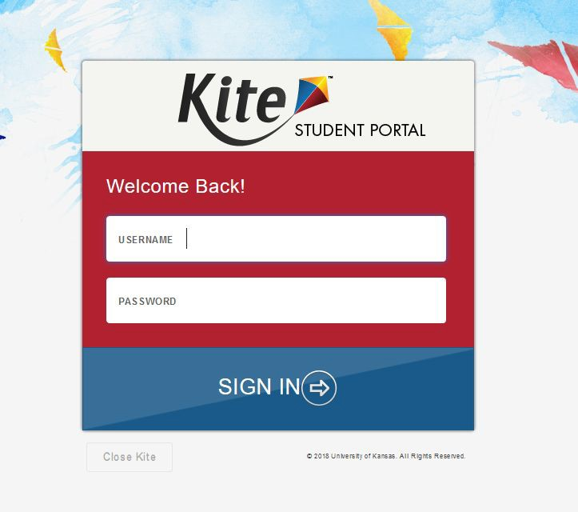
Kite Student Portal
Students will test online using the Kite Student Portal.

Slide 68

General Summative Assessments
Subject | Grades | Estimated Time to Complete (untimed)
Mathematics | 3 - 8, and 10 | Two Sessions, 45-60 minutes each
English Language Arts | 3 - 8, and 10 | Two Sessions, 45-60 minutes each
Science | 5, 8, and 11 | Two Sessions, 45 minutes each

Slide 69
Changes for Summative Assessment
Updated blueprints for summative assessment.
All new items for summative assessment.
Summative test has a max of 40 to 50 score points.
New cut scores will be determined in summer of 2025.
  Student score reports will be available after SBOE approves cut scores in fall of 2025.

Slide 70
Changes for Summative Assessment
New Proposed Performance Level Descriptors.
Increased use of block-based items.
Removal of stand-alone writing items.
All writing items are embedded in passage-based blocks.

Slide 71
2 Sets of Performance Level Descriptors
Assessment Level Descriptors- overall description of performance on summative assessment.
Performance Level Descriptors (grade speciﬁc)- standards based descriptors. Available in the fall of 2024.
Goal for new assessments – use common terms to be less confusing.

Slide 72
Current Performance Level Descriptors
Level 1: A student at Level 1 shows a ability to understand and use
limited
the skills and knowledge needed for postsecondary readiness.
Level 2: A student at Level 2 shows a ability to understand and use the
basic
skills and knowledge needed for postsecondary readiness.
Level 3: A student at Level 3 shows an ability to understand and
eﬀective
use the skills and knowledge needed for postsecondary readiness.
Level 4: A student at Level 4 shows an ability to understand and
excellent
use the skills and knowledge needed for postsecondary readiness.

Slide 73
Proposed Performance Level Descriptors
A student at Level 1 shows a ability to demonstrate their knowledge and skills of
limited
(third, fourth, ﬁfth, etc.) grade (ELA, Math, Science) Kansas standards.
A student at Level 2 shows a ability to demonstrate their knowledge and skills of (third,
basic
fourth, ﬁfth, etc.) grade (ELA, Math, Science) Kansas standards.
A student at Level 3 shows a ability to demonstrate their knowledge and skills of
proﬁcient
(third, fourth, ﬁfth, etc.) grade (ELA, Math, Science) Kansas standards.
A student at Level 4 shows an ability to demonstrate their knowledge and skills of
advanced
(third, fourth, ﬁfth, etc.) grade (ELA, Math, Science) Kansas standards.

Slide 74
Interim Assessments
Updated blueprint.
All new items for interim assessment.
Interim assessments better aligned with instructional sequence.
Results designed to be used to improve instruction.

Slide 75
Interim Assessments
Moving from 3 Interims to 2.
ELA & Math grade 3 - 8 & 10.
Introduction of interims for science grade 5 and 8.
Introduction of middle school focused interims.

Slide 76
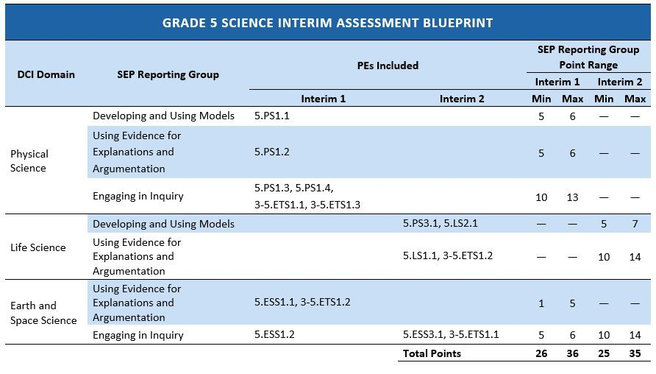
Example of Interim Assessment Blueprints

Slide 77
Assessment Development Guides
Assessment Development Guides (Blueprints) will be available on KAP website for ELA, math, and science
  Summative
  Interim

Slide 78
Updated Mini-tests
New items in test bank
Standards speciﬁc
ELA, math, and Science
Standards Based Report in Kite

Slide 79
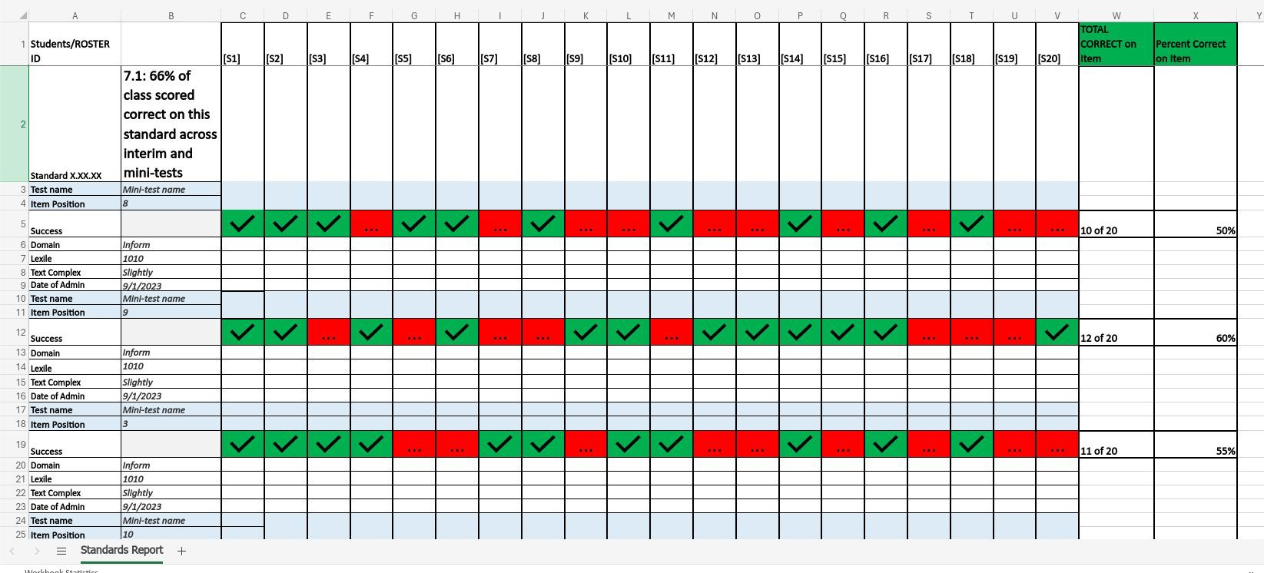
Standards Based Report (demo)

Slide 80

Julie Ewing Assistant Director
Career, Standards and Assessment Services (785) 296-2325
jewing@ksde.org
The Kansas State Department of Education does not discriminate on the basis of race, color, national origin, sex, disability or age in its programs and activities and provides equal access to the Boy Scouts and other designated youth groups. The following person has been designated to handle inquiries regarding the nondiscrimination policies: KSDE General Counsel, Oﬃce of General Counsel, KSDE, Landon State Oﬃce Building, 900 S.W. Jackson, Suite 102, Topeka, KS 66612, (785) 296-3201.

Slide 81
  Ben Proctor
  Deputy Commissioner
  Division of Learning Services
  (785) 296-2304
  bproctor@ksde.org

